Slide 1
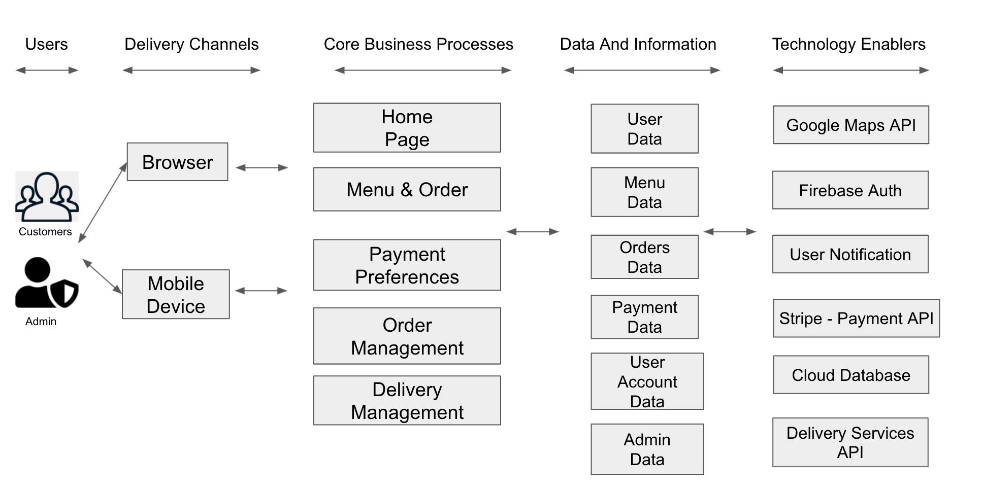
Inwood Bagels Web Application Architecture Type: Application Architecture View: Logical View Style: Layered Architecture Pattern

Slide 2
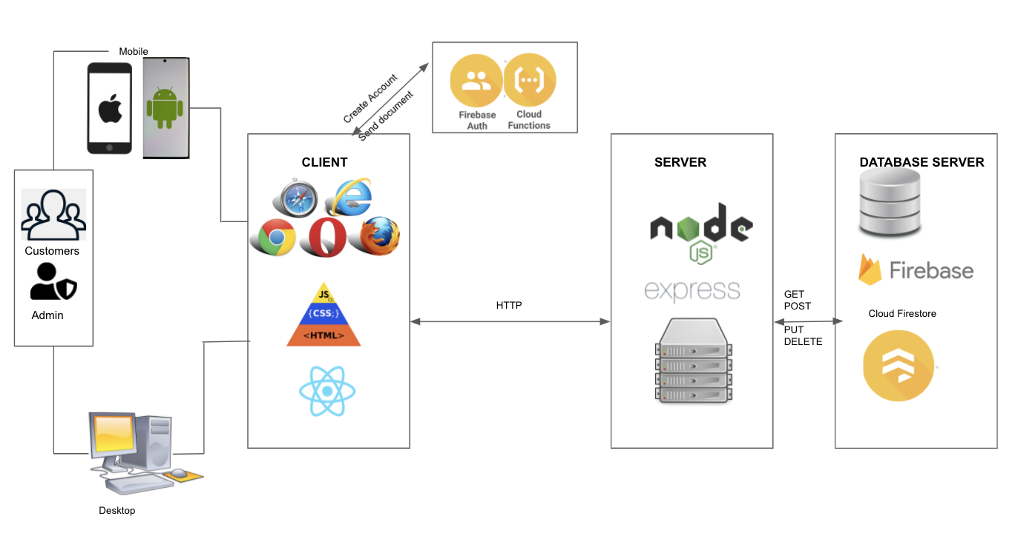
Inwood Bagels Web Application Architecture Type: Application Architecture View: Process View Style: Client-Server Pattern

